Slide 1
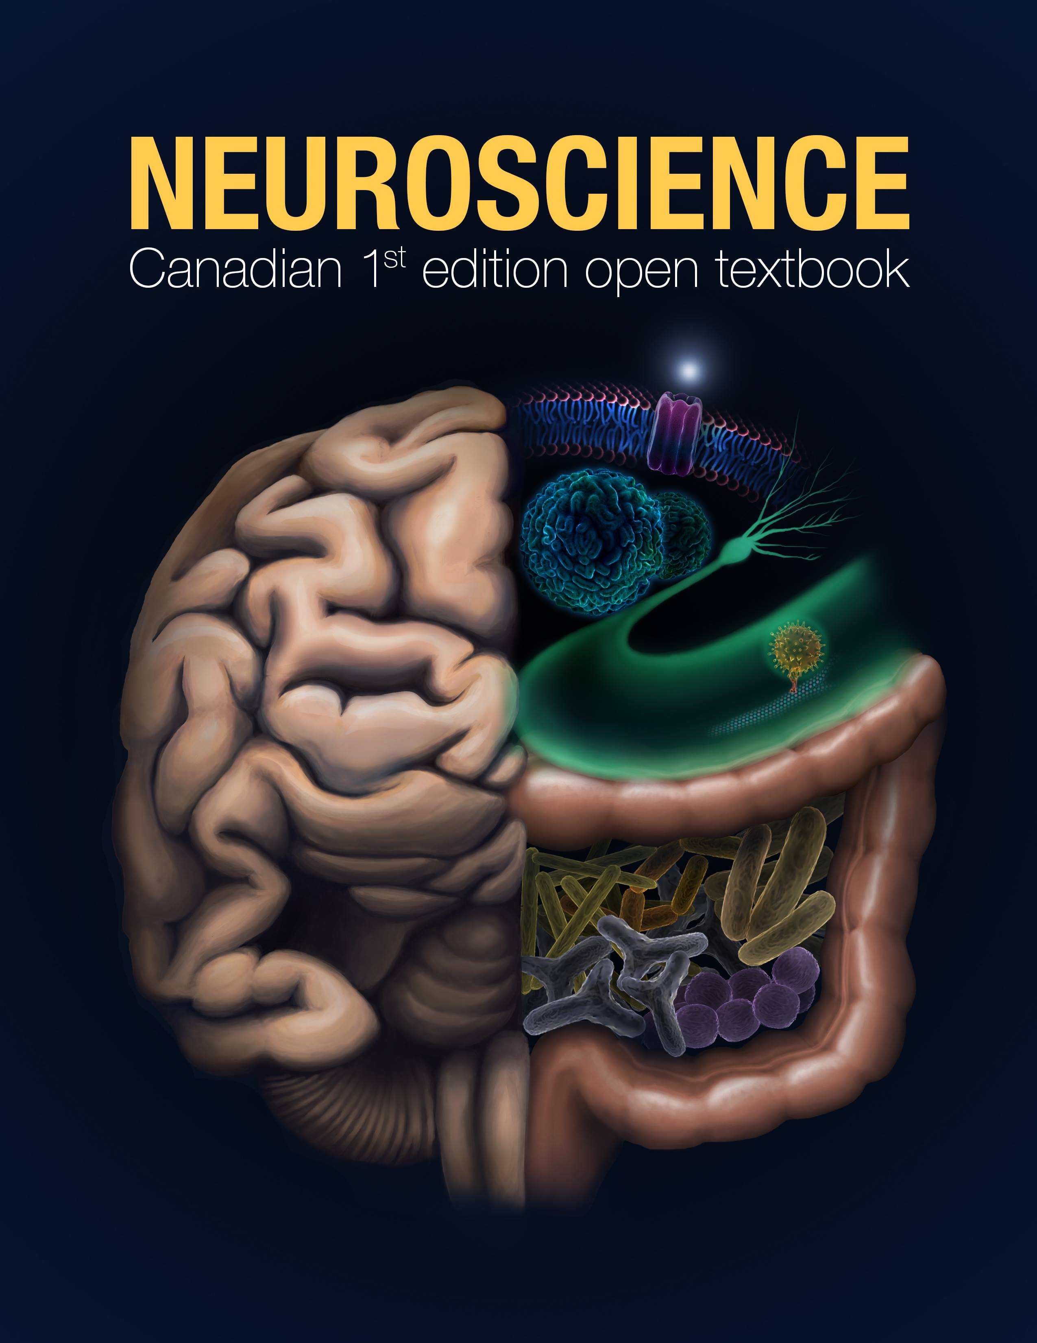

Cognitive Neuroscience and religion
People often see science as something that contradicts and contrasts with religion
Science is about matter, and proving hypotheses.
Religion is about spirit, and having faith.
Cognitive scientists study how we come to understand the world.
They say that our religious experiences are the result of material changes to our brains and seek to explain common:
Belief in gods, ancestors, ghosts, demons (the god faculty, Richard Dawkins 2006)
Rituals
Near death experiences and other things
This Photo b Unknown Author is licensed under CC BY

Slide 2
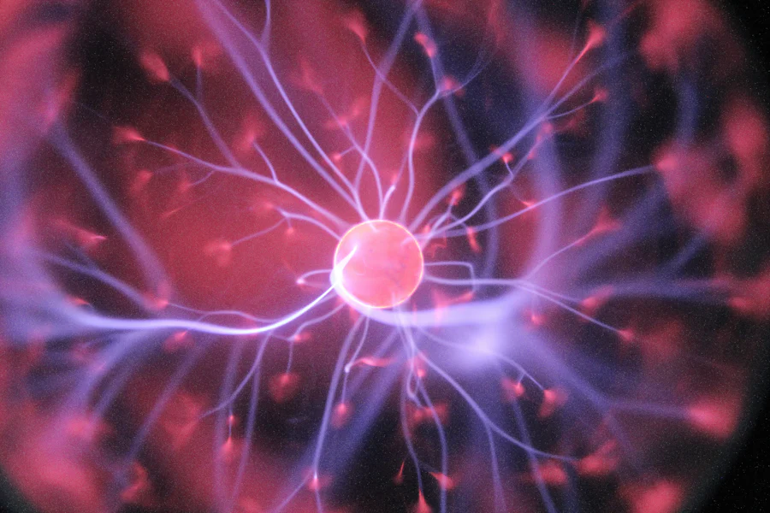
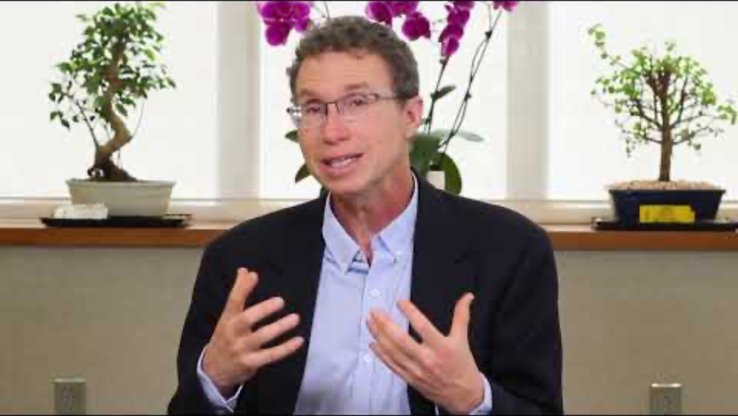
Ecstasy and Science: What is neurotheology?
What is neurotheology?:
Andrew Newberg defines it as:
‘the field of study linking the neurosciences with religion and theology’ (p. 45)
Andrew B. Newberg Principles of neurotheology. Routledge, 2016.
Neurotheology studies the impact of religion, and religious activity on the brain.
Explains something spiritual like religion using the scientific study of brain matter & in particular the neurons of brain.
Reduces religious experiences like ecstasy to cause and effect.
Hal Gatewood, Unsplash
https://www.youtube.com/watch?v=nXnzqB-Y5T8. Andrew Newberg, MD - Neurotheology: How Science Can Enlighten Us About Spirituality 3 mins

Slide 3
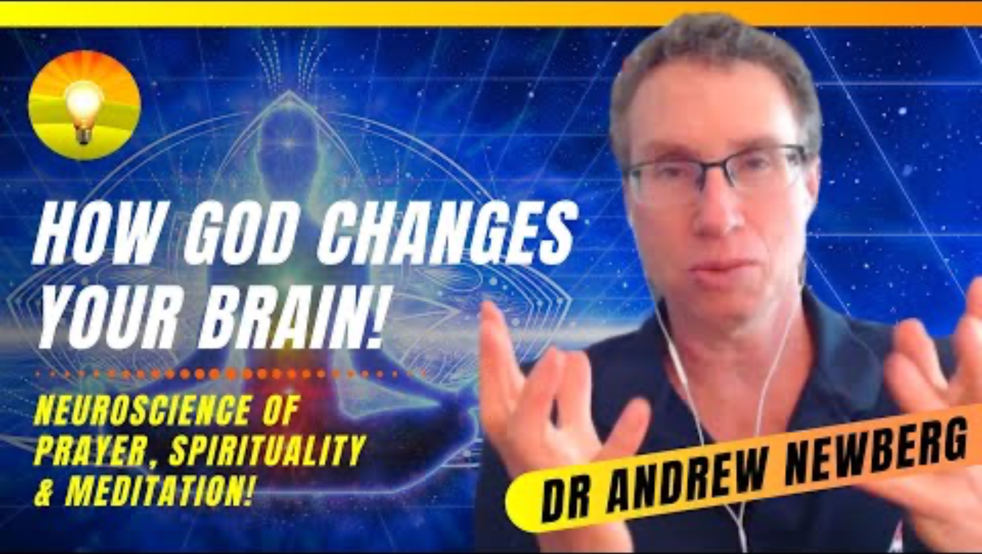
Does ecstasy change your brain?
How God Changes the Brain! Neuroscience of Prayer, Spirituality and Meditation! Dr. Andrew Newberg (1 hour) https://www.youtube.com/watch?v=qp_sqMIOMcs&list=PLdzkGUygIR0fQKz6i1GUFjfRF_rku6Nnf

Slide 4

Religion is about spirit not matter/or spirit and matter
People who experience ecstasy in religious contexts focus on spirit not matter
They don’t necessarily need proof and material evidence of supernatural beings
That being said some religious groups do focus on the importance of miracles
These miracles show people who prayed for healing, to be healed and those who prayed for a sign receiving it.
Cognitive scientists prioritize material evidence over spiritual belief (without proof).
The film Mystical Brain investigates the transformed brains of Carmelite nuns while they experience religious ecstasy
Subjective account of experience

Slide 5
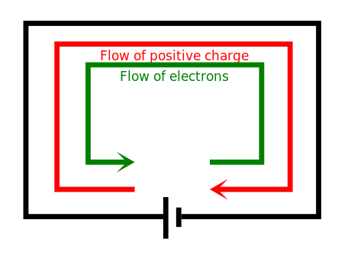

Reflection questions
Is Neuroscience anti-religion?
If we can measure changes to the brain when people say they feel ecstasy, does that mean religious experiences are in their heads? What about embodiment? How can that be measured?
What do you think about new research suggesting that the spiritual part of taking mind-altering drugs is more important than the chemical compounds in the drugs? Some studies have shown that if you take drugs out of their spiritual traditional contexts, their efficacy for use in the treatment of depression, addiction, PTSD and other things dramatically declines.

